Slide 1



fullstackdatascience.com
Lesson 11 - Domain Knowledge
Mobile App
Power BI
Created by Huydata
DA K6
Lesson 3
huynt@fullstackdatascience.com
1

Slide 2

Learn
About
01/
Domain Knowledge Mobile App
02/
Lab
fullstackdatascience.com
2

Slide 3
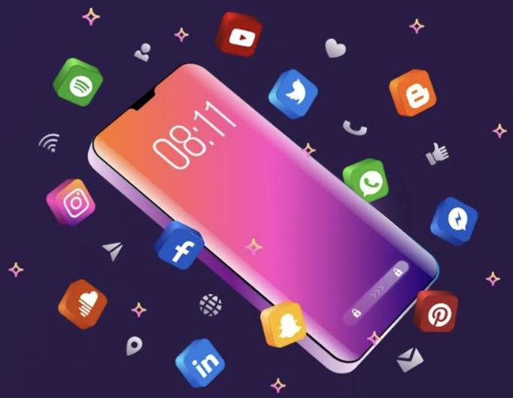
Mobile App
Mobile App is an application that is downloaded and installed directly on a mobile device. To use it, you need to download the application first.
3

Slide 4
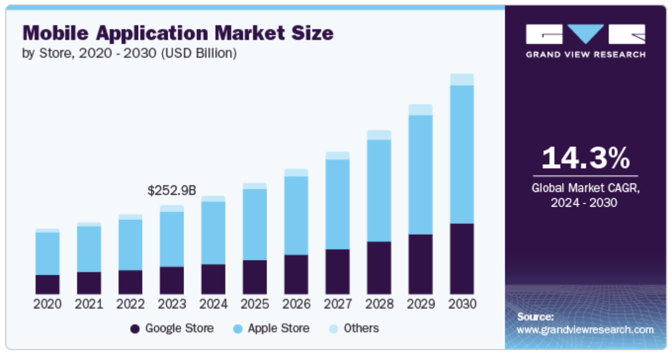
Market Size
5

Slide 5
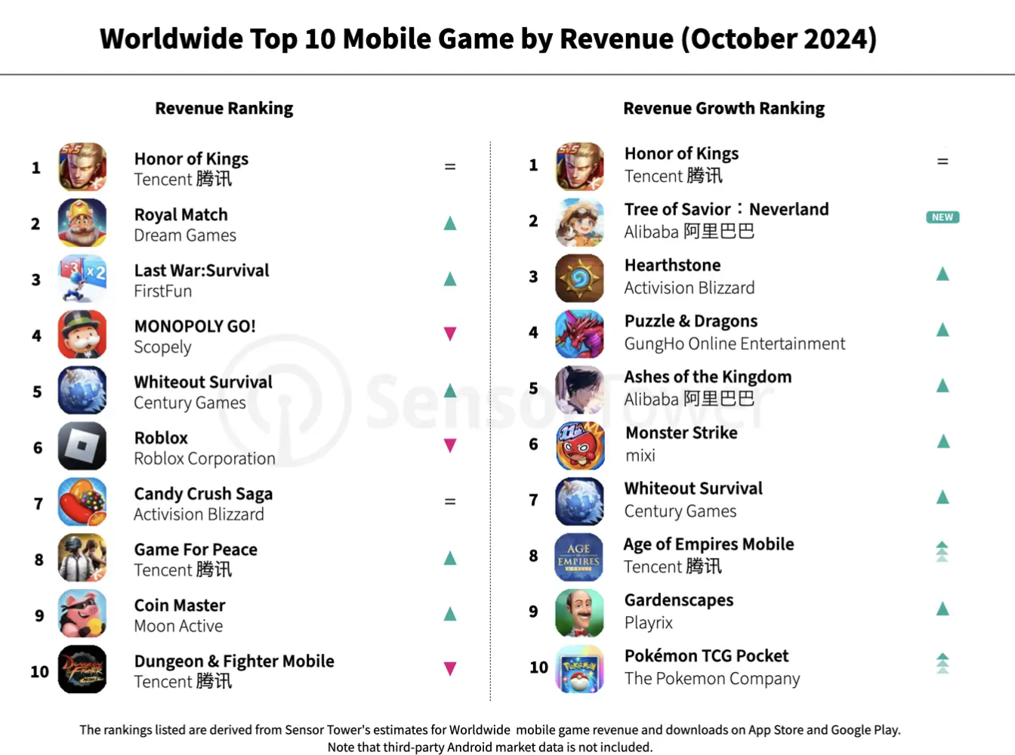
Top 10 Worldwide Mobile Games By Revenue
5

Slide 6
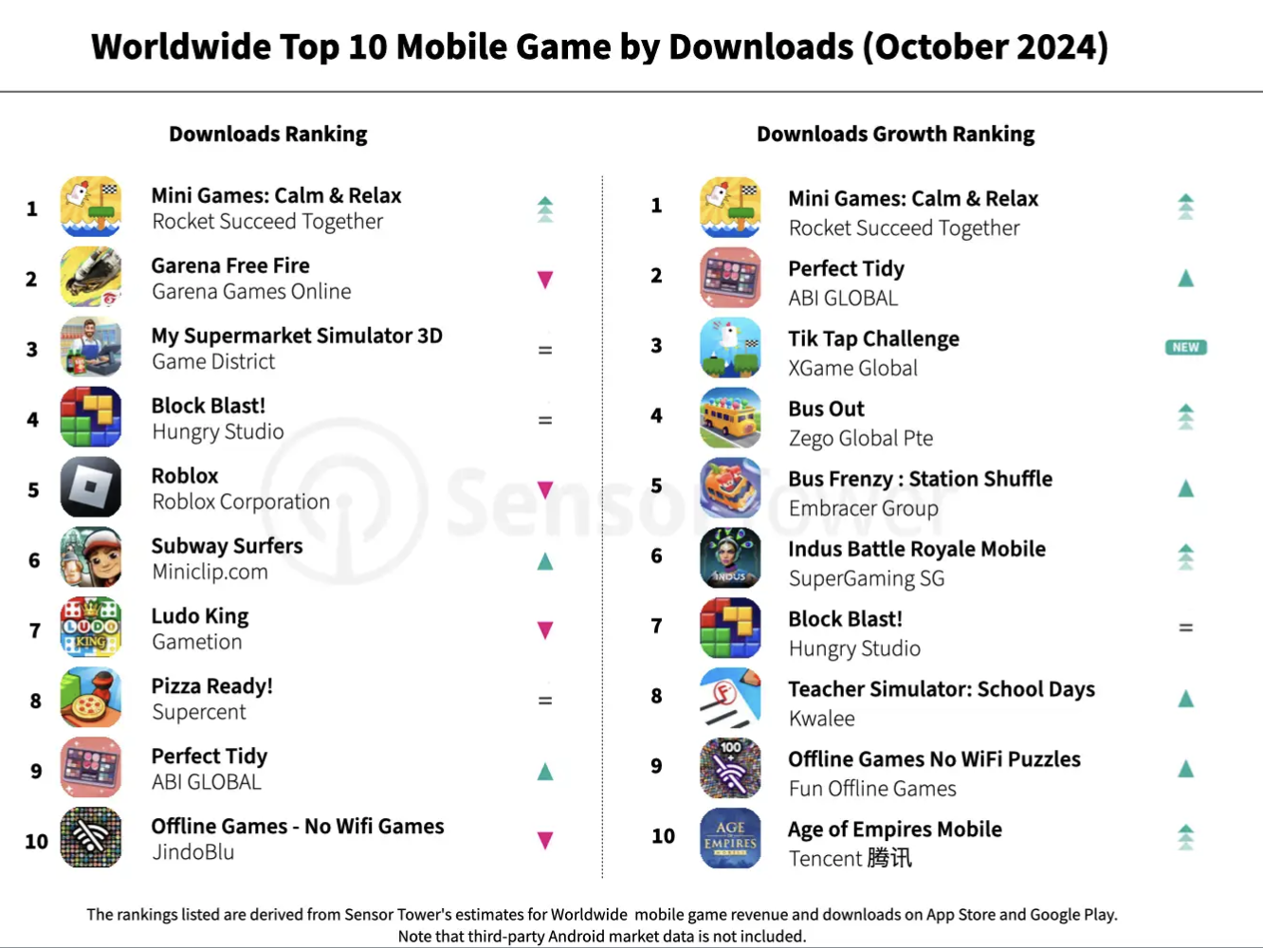
Top 10 Worldwide Mobile Games By Download
5

Slide 7
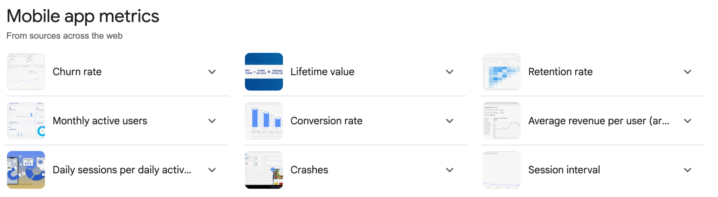
Key Metrics in Domain Knowledge
5

Slide 8
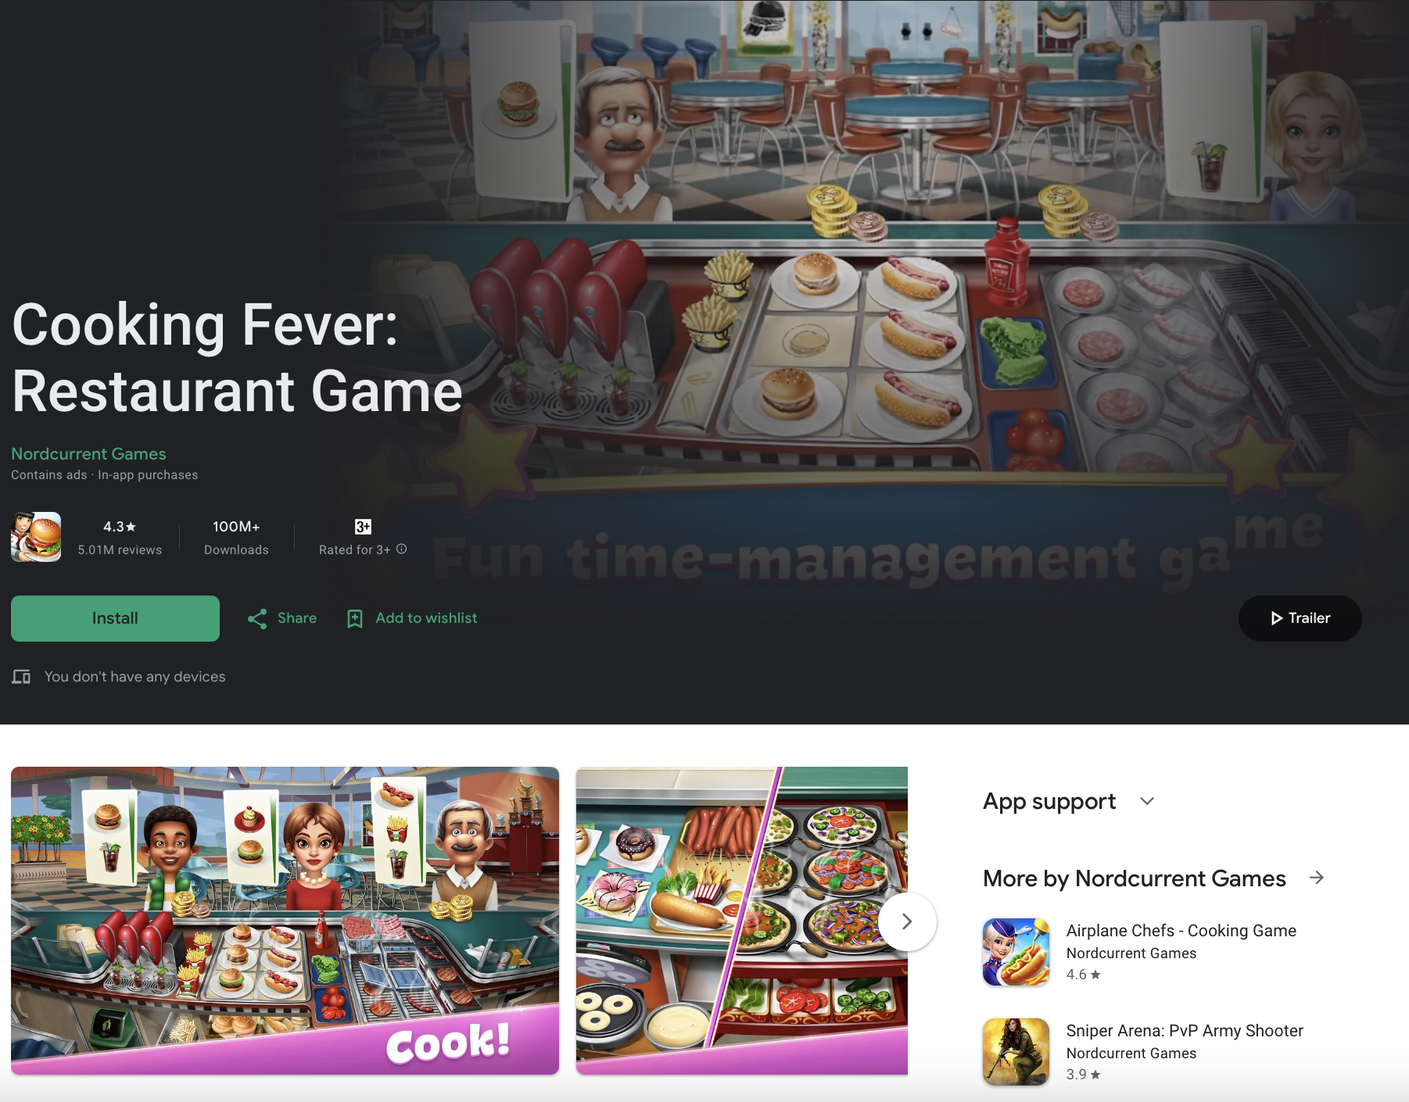
Practices
3

Slide 9
Cooking Fever
Android: https://play.google.com/store/apps/details?id=com.nordcurrent.canteenhd&hl=en
IOS: https://apps.apple.com/lt/app/cooking-fever/id714796093
5

Slide 10

fullstackdatascience.com
References
https://dataedo.com/samples/html/Data_warehouse/doc/AdventureWorksDW_4/home.html
11

Slide 11





Thank you
096 574 90 25
CREATED BY
Nguyen Tien Huy
info@robusto.ai
fullstackdatascience
huynt@fullstackdatascience.com
Data Manager
https://fullstackdatascience.com/
Hanoi, Vietnam

